Slide 1

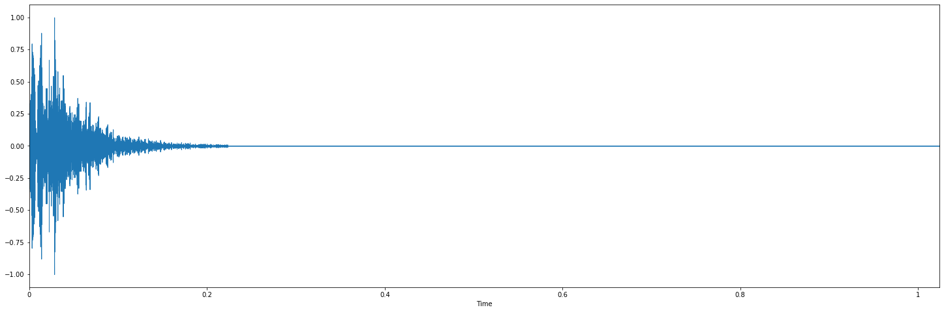

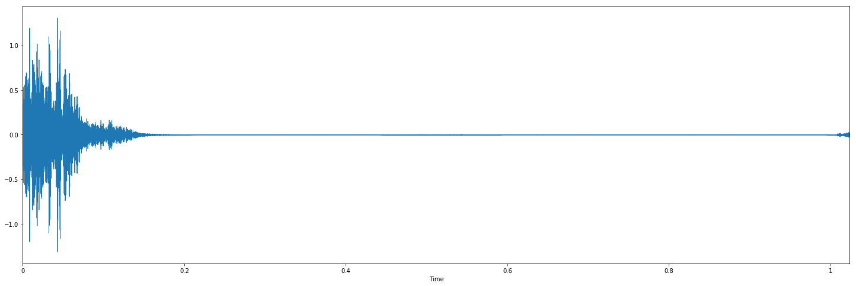
Achievement
Starting from simple example to test the network. Adjust hyper parameters.
Drum audio have 2350 training data with 8 type of audio: clap, cowbell, crash, hat, kick, ride, snare and tom
Clap:
real data
fake data

Slide 2
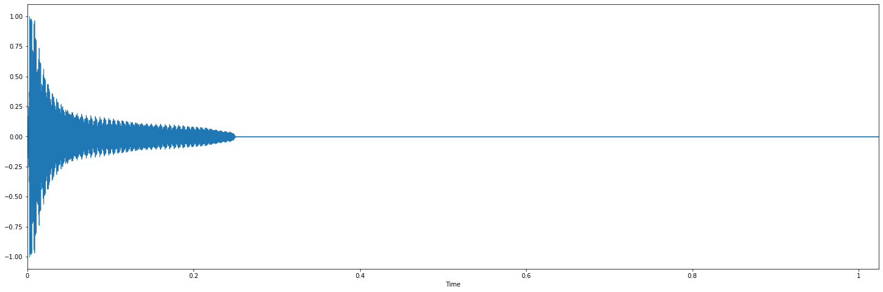
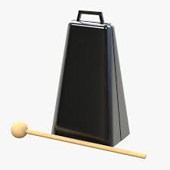
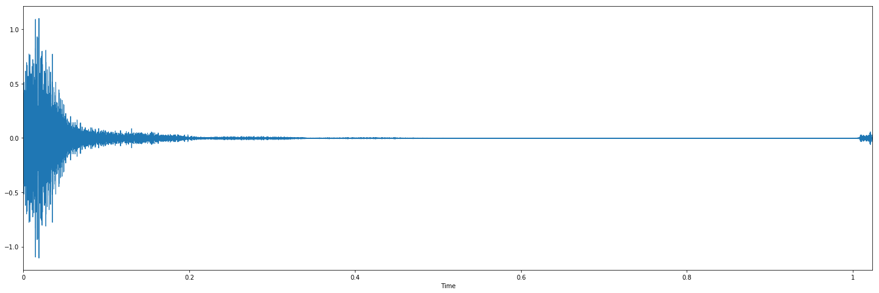
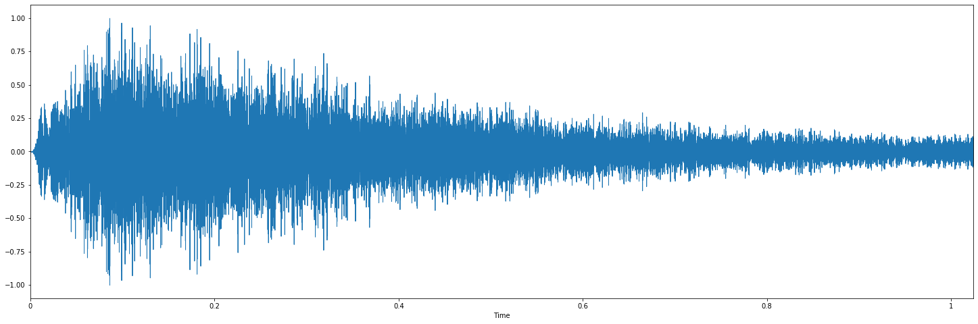
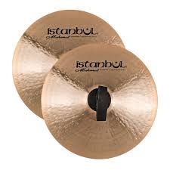
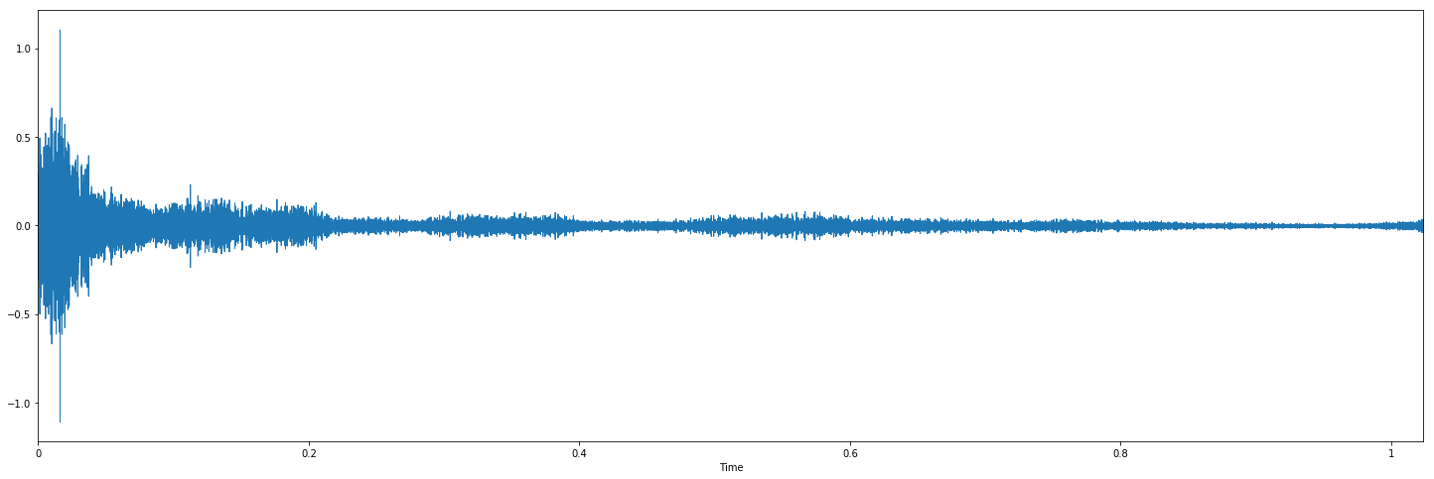
Achievement
Cowbell:
real data
fake data
Crash:
real data
fake data

Slide 3
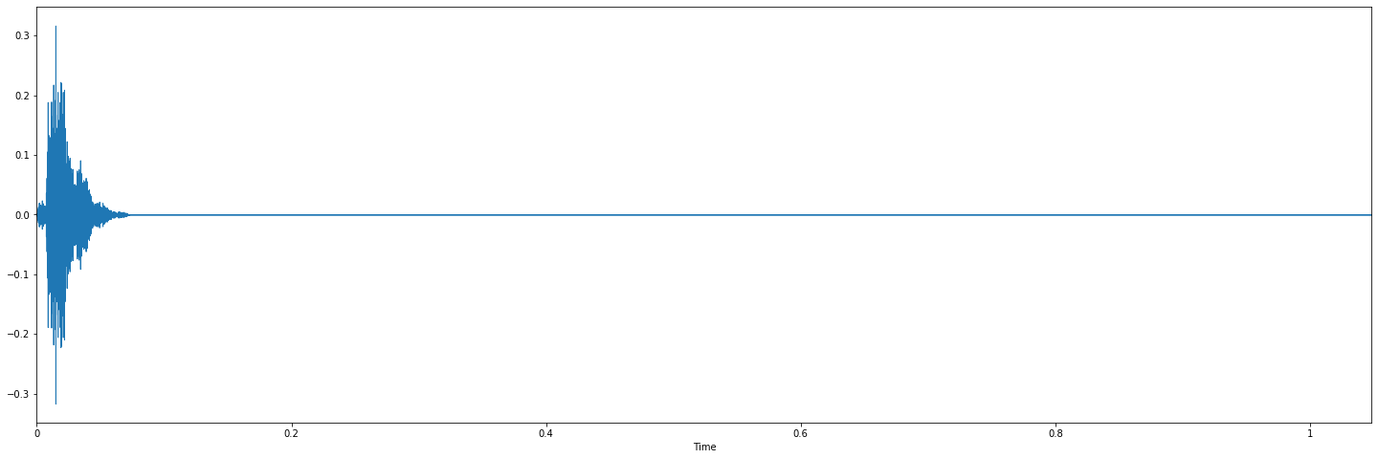
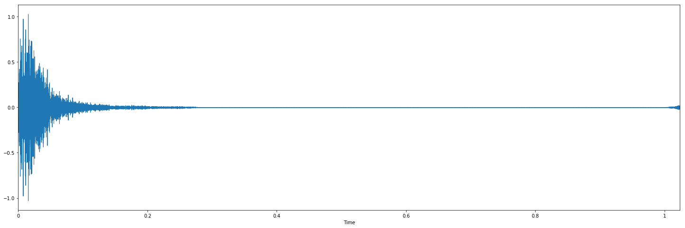
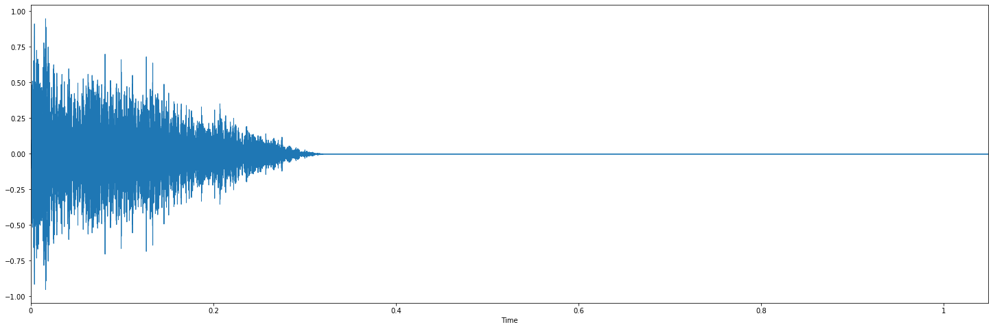
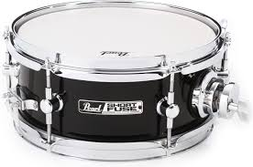
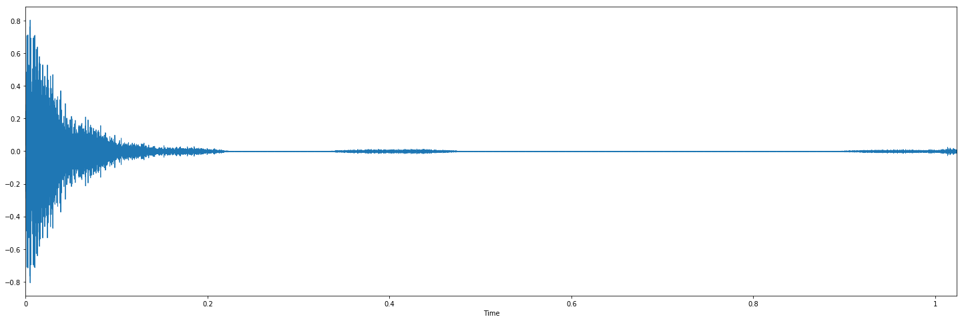
Achievement
Hat:
real data
fake data
Snare:
real data
fake data

Slide 4
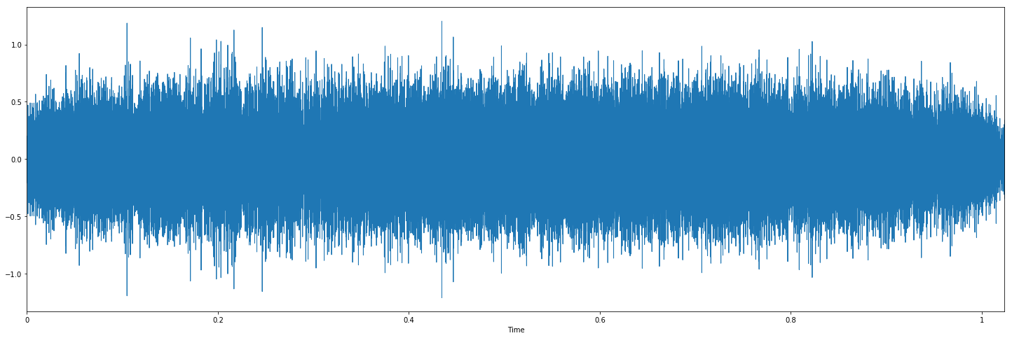
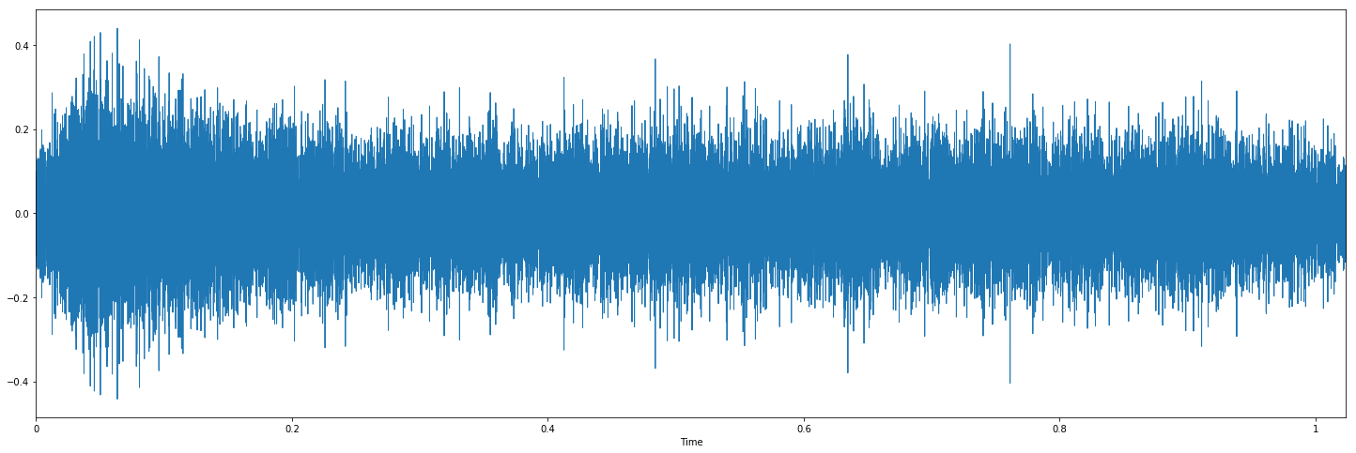
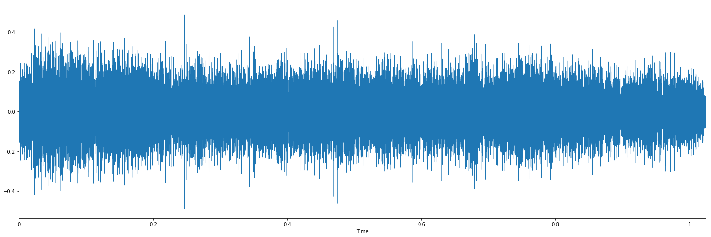
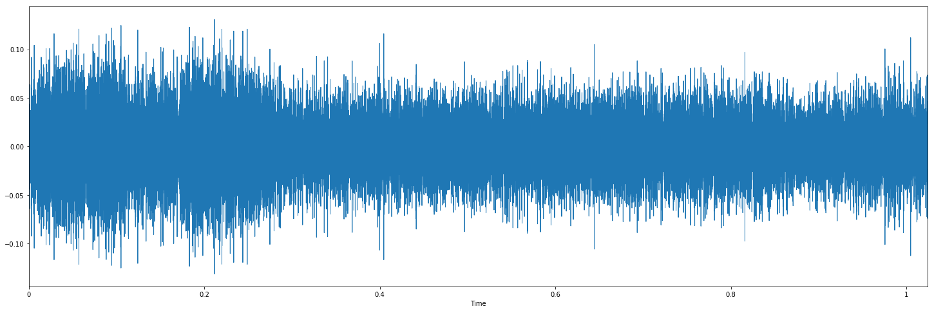
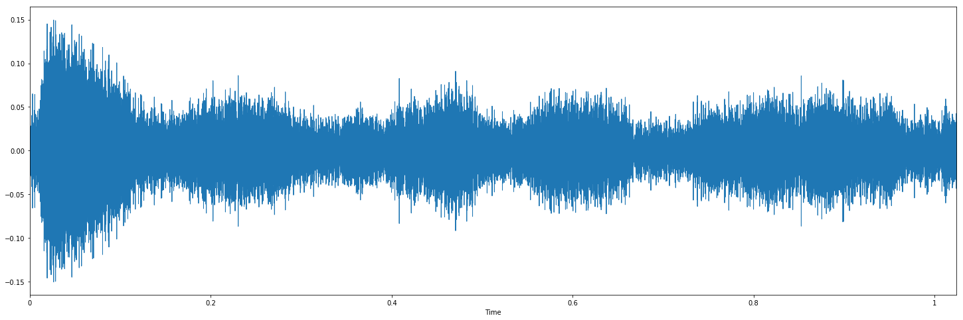
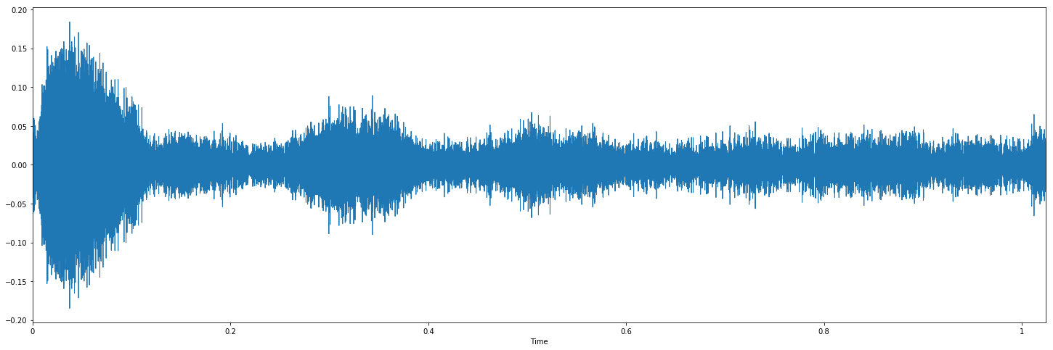
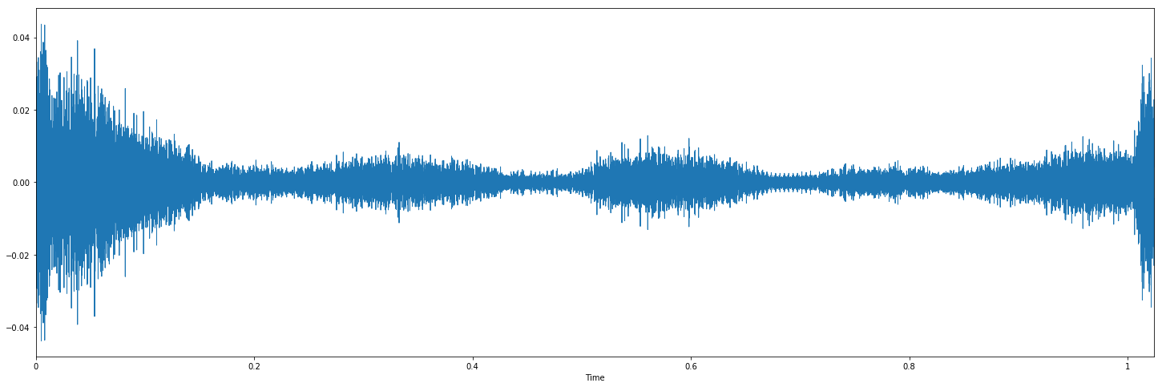
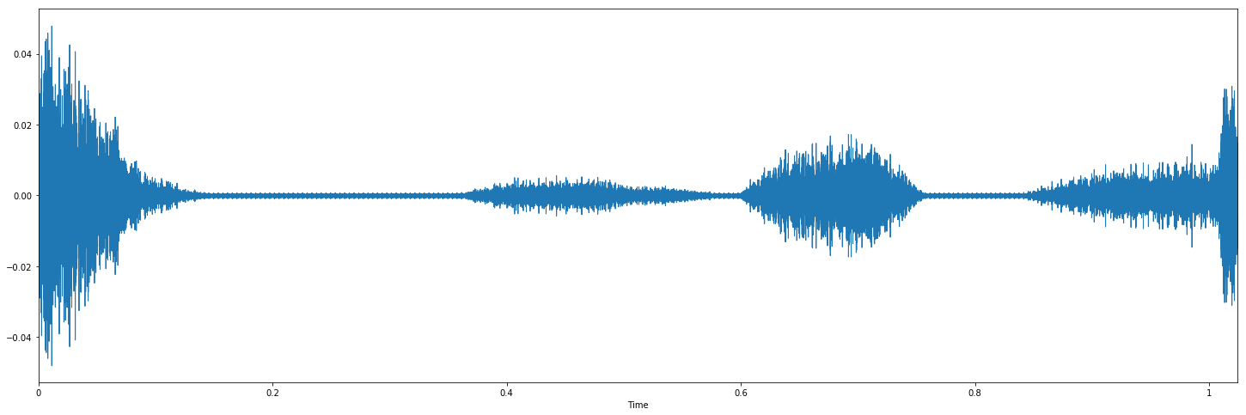
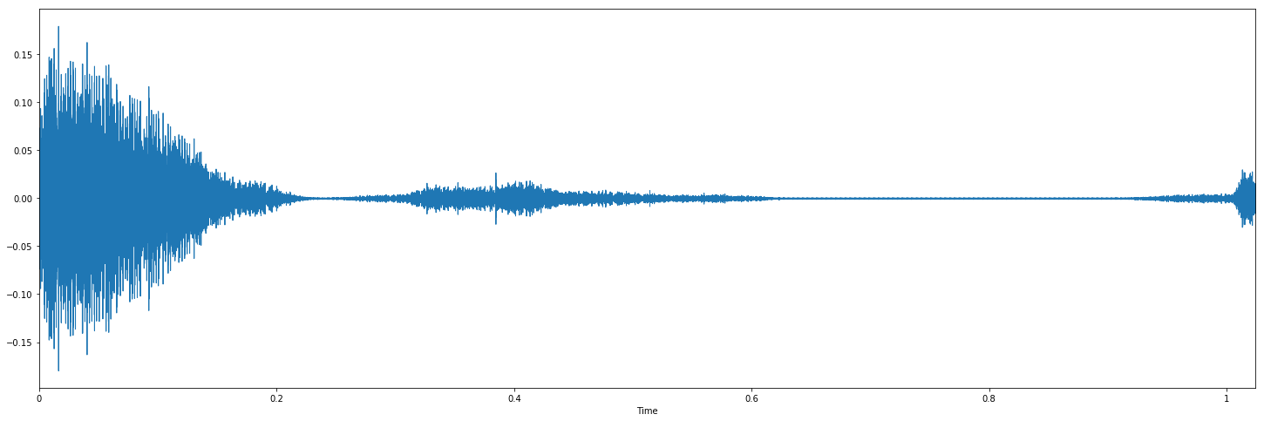
Achievement
The formation process of a drum waveform
200 epoch
400 epoch
1000 epoch
2500 epoch
3000 epoch
4000 epoch
4500 epoch
1500 epoch
2000 epoch

Slide 5
Achievement
After attempt the simple audio, i am going to try to training bird sounds
10000+ bird sounds had been downloaded from the xeno-canto[1] which is a website dedicated to sharing bird sounds
And all the bird sounds have been sampled in one second, finally i got 50000+ audio sample
I trained nearly two weeks, but the result is not so good
Bird sounds:
real data
fake data
[1] Peter Boesman. Bird recordings. https://www.xeno-canto.org/contributor/OOECIWCSWV, 2018. Accessed: 2018-01-08.

Slide 6
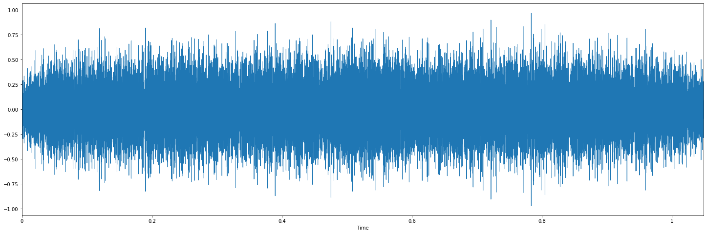
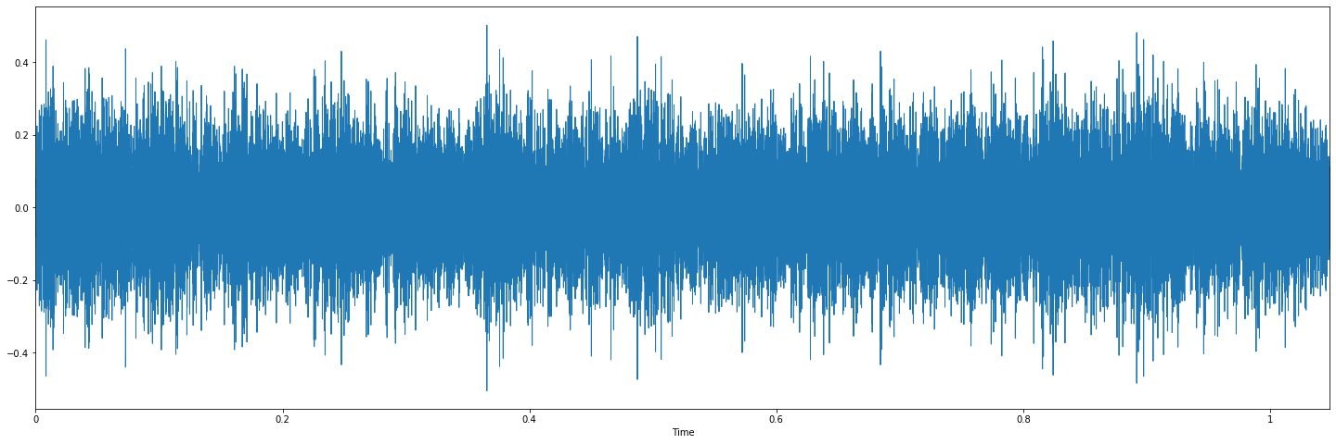
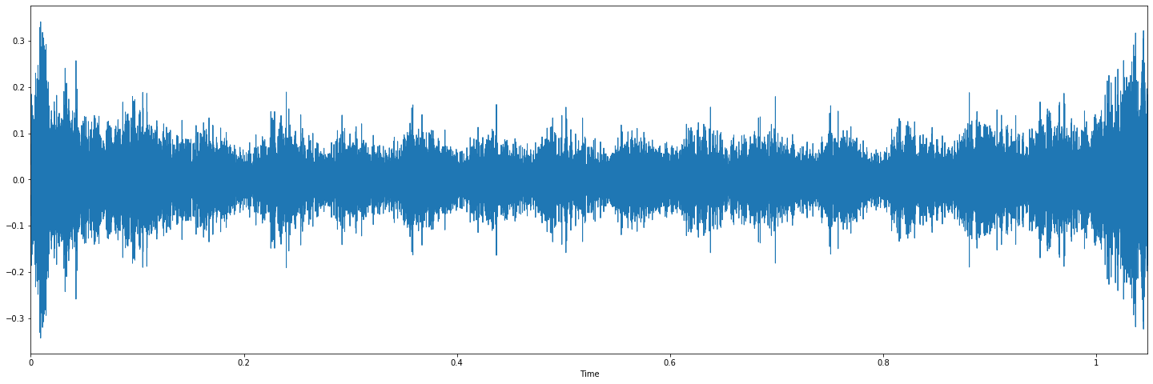
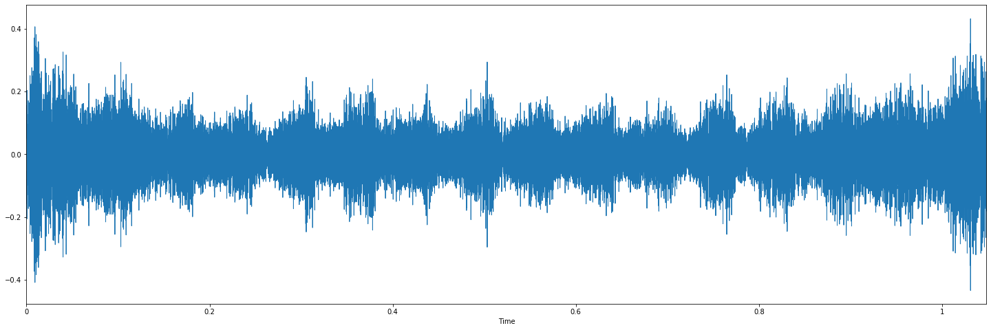
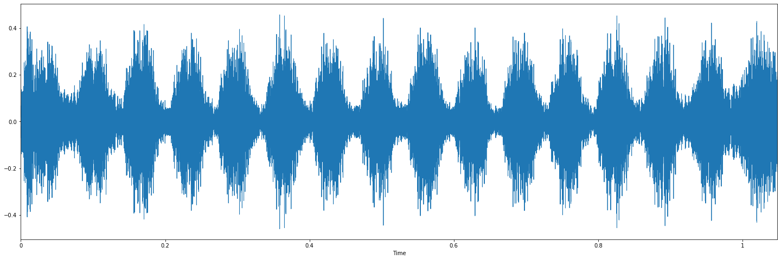
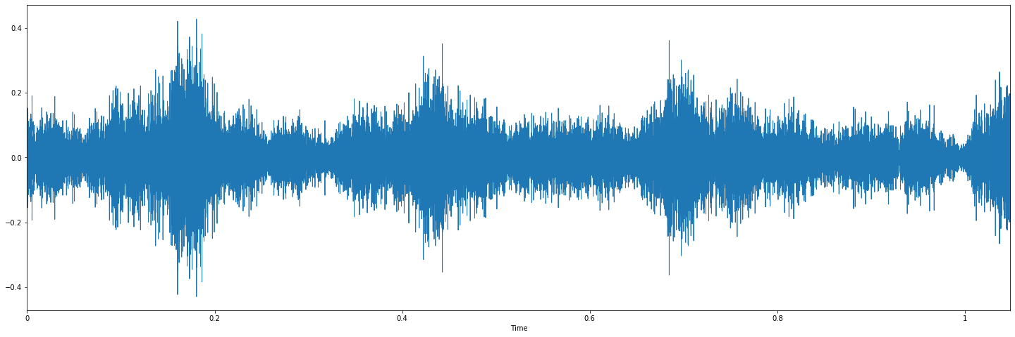
Achievement
The formation process of a bird waveform
200 epoch
2000 epoch
2600 epoch
3000 epoch
3600 epoch
8000+ epoch

